Slide 1
Historical Market Performance analysis. Market cap weight (SPY) or Equal Weight (RSP) strategy.
Presented by James Guffogg
Presented to Elijah Douglas
04/03/2023

Slide 2
Goals of this presentation.
Explore the performance of two Exchange Traded Funds (ETFs) – SPY & RSP.
To understand how two different investing strategies influence returns. (Market-cap weighted or Equal weight)
To assess the performance of a $10,000 investment in SPY & RSP from the 1st of May 2003 to the 13th of March 2023.

Slide 3
Introduction
So, what is an Exchange Traded Fund (ETF)?
“Type of security that tracks an index, bonds, commodities, currencies or a mix of various asset classes.” (Yahoo Finance, 2019)
While both ETFs we’ll be analyzing today track the S&P 500 index, they take two different approaches.
But first, what is the S&P 500?
A stock market index that measures the performance of 500 companies.
For inclusion, companies must be US based, have a Market Capitalization of at least $8.2B, offer a common stock option, and have positive earnings over the four most recent quarters.
Consequently, the criteria mean only the country’s largest & most stable are included.
SPY – SPDR S&P 500 ETF Trust – State Street Global Advisors.
Market-cap weighted approach.
The top 10 holdings account for 27.52% of its total assets.
Top 3 holdings, AAPL – 7.18%, MSFT – 6.29%, and AMZN - 2.64%, account for 16.11%.
RSP - Invesco S&P 500 Equal Weight ETF – Invesco.
Equal-weight approach.
The top 10 holdings account for 2.32% of its total assets.
Equivalent holdings, AAPL – 0.22%, MSFT – 0.23%, AMZN – 0.22%, account for 0.67%.
No single holding accounts for more than 0.24% of assets allocated.
Information on fund holdings is current as of 03/24/2023.

Slide 4
Hypotheses.
Hypothesis 1: Market cap or Equal weight performance.
Null: There is no statistically significant difference in the performance of a market-cap-weighted strategy (SPY) or an equal-weight strategy (RSP). Ho: μ1 - μ2 = 0.
Alternate: A statistically significant difference exists in the performance of a market cap (SPY) or equal-weight strategy (RSP). Ha: μ1 - μ2 ≠ 0.
Hypothesis 2: Correlation of returns.
Null: There is no correlation between the daily returns of SPY and RSP. Ho: μ1 - μ2 = 0.
Alternate: There is a positive correlation between the daily returns of SPY and RSP. Ha: μ1 - μ2 ≠ 0.

Slide 5
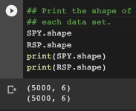
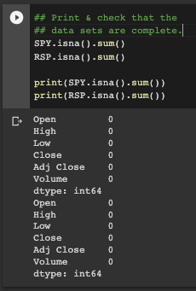
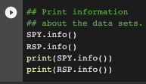
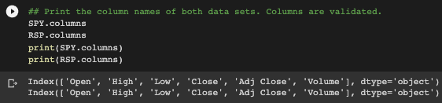
About the data.
For this analysis, each data set was downloaded from Yahoo Finance via the yfinance Python API.
Each data set has 5000 rows and 6 columns, and they’re both complete.
Columns – Open, Close, Adjusted Close, High, Low, Volume.
Close or Adjusted Close?
Close is the raw price of the last transaction before the market closes. The Adj Close amends the price to account for corporate actions like stock splits/dividends or earnings. We’ll be using the Adj Close in any calculations.
The sample time frame for this data was from the 1st of May 2003 to the 13th of March 2023. Why?
SPY inception date: 01/22/1993
RSP inception date: 04/24/2003
Data types – 5 columns are floats (numbers with a decimal point), and 1 column is an integer (whole number).
SPY.info()
RSP.info()

Slide 6

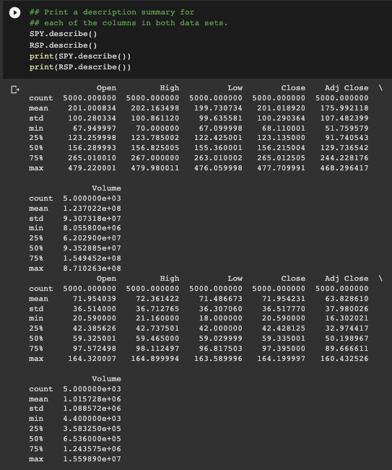
Methods.
This analysis was done using Python in Google Colab.
Necessary libraries were imported; Pandas, NumPy, Seaborn, Matplotlib, SciPy, and yfinance.
yfinance was installed using the Yahoo Finance Python API.
!pip install yfinance.
Data sets for both funds were downloaded from 05/01/2003 to 03/13/2023.
A description summary for both data sets was generated.
Count, mean, std, min, 25%, 50%, 75%, and max.
Both data sets were cleaned, explored, checked for completeness using the Pandas library, and then analyzed using a combination of statistical tests from the SciPy and Seaborn libraries.
T-test, assuming unequal variance, Regression Analysis, and a Correlation Coefficient with a Pearson test.
stats.ttest_ind() / .pearsonr / .corr / sns.regplot / sp.stats.linregress.
The results were then visualized using Matplotlib.pyplot library.
Notes:
The 25% value is the first quartile (Q1), which is the value below which 25% of the data falls.
The 50% value is the second quartile (Q2), which is the median value of the data, below which 50% of the data falls.
The 75% value is the third quartile (Q3), which is the value below which 75% of the data falls.
The unequal variance t-test assumes that the variances of the two groups are not equal. This assumption is made because in practice, it is often difficult to know whether the variances of the two groups are equal or not, and in many cases, the variances are indeed unequal.
Variance is a measure of how spread out a dataset is around its mean or expected value. It is a numerical value that indicates the degree of variability or dispersion of a set of data points.

Slide 7
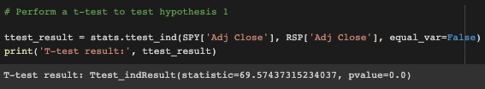
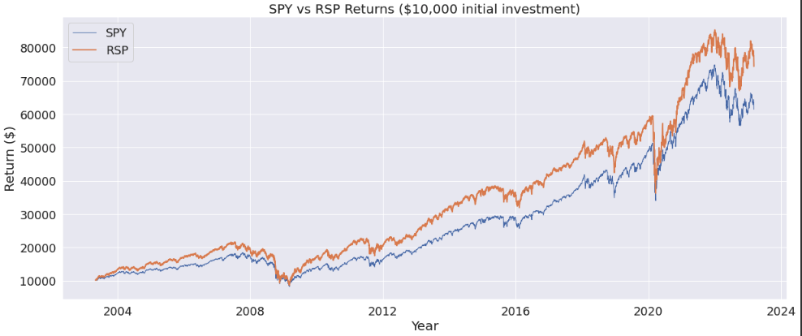
Results.
Hypothesis 1: Market Cap or Equal Weight performance.
Null: There is no statistically significant difference in the performance of a market-cap-weighted strategy (SPY) or an equal-weight strategy (RSP).
Ho: μ1 - μ2 = 0.
The results of the T-test opposite show a p-value of 0.0. In this case, the p-value is so small, that SciPy rounds it to 0.0.
We can reject the Null Hypothesis that there is no statistically significant difference in the performance of the two strategies.
P < 0.05.
A low p-value means that our result is unlikely to have occurred by random chance.
A $10,000 investment in SPY on the 1st of May 2003 would now be worth $61,386. Represents a gain of %513.86.
That same $10,000 investment in RSP on the same day, however, would now be worth $74,275. That represents an increase of %642.75.
The equal weight strategy of RSP generated an additional $12,889 over its market cap-weighted competitor, in the measured time period.

Slide 8
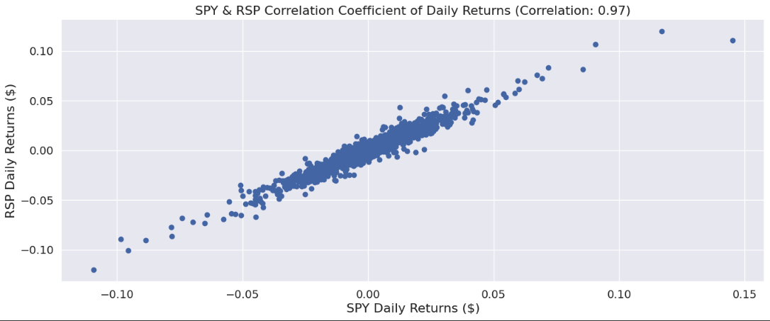
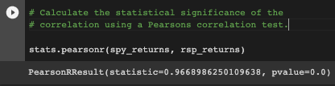
Results cont.
Hypothesis 2: Correlation of returns.
Null: There is no correlation between the daily returns of SPY and RSP.
Ho: μ1 - μ2 = 0.
+1 indicates a perfect positive correlation.
0 indicates no correlation at all.
-1 indicates a perfect negative correlation.
Therefore, a correlation coefficient of +0.97 suggests a highly correlated relationship.
To check the statistical significance of the correlation, a Pearson's correlation test is conducted.
The results of the T-test opposite show a p-value of 0.0. In this case, the p-value is so small, that SciPy rounds it to 0.0.
We can reject the Null Hypothesis that there is no correlation between the daily returns of SPY and RSP. P < 0.05.

Slide 9
Discussion
So, who’s the end user, and what value does the data bring?
End-user;
Financial advisors and their clients, Retail investors, Pension funds, Investment banks, etc.
Invesco and State Street Global Advisors – Fund creators.
Are they charging enough (Management Fee) given the returns the funds offer?
Are they promoting this data enough to encourage additional capital to flow in to their respective ETFs?
Value;
Provides data-driven insights in order to make data-driven decisions.
Provides historical insight into the effectiveness of two different investment strategies.
Allows financial advisors, who are looking to deploy client capital, to justify their recommendations.
It provides evidence that passive investing can be very effective.

Slide 10
Scope for further Research.
Is SPY overly reliant on the top 3/ top 10 companies it holds?
Companies outside the top 10 are under-allocated and their influence on SPY potentially isn’t sufficient. Can we test a re-balancing?
Is SPY weighing the right sectors? Does it re-balance often enough?
There are 11 sectors of the S&P, illustrated on the next slide.
How would SPY or RSP have performed had Energy, for example, had a larger weighting (particularly in the last 2.5 years)?
How do both investment strategies fare in a bear market/recessionary environment?
How does the performance of SPY & RSP compare to that of a single stock like AAPL?
Does either of these strategies perform better than an actively managed portfolio by a financial professional?
Can I leave my money in either of these funds, forget about them, and make more than I would have by paying a professional? Passive or Active investment.
Notes:
A bear market is a period when investments have fallen at least 20% from recent market highs.

Slide 11
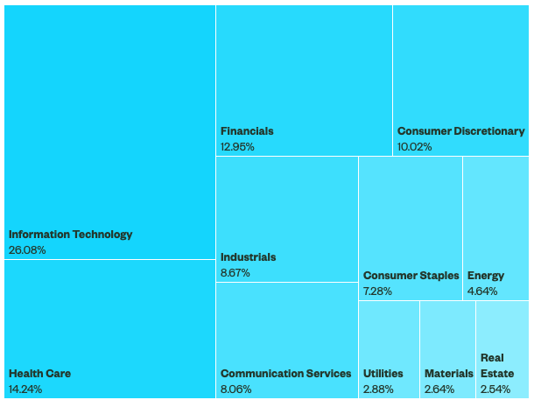
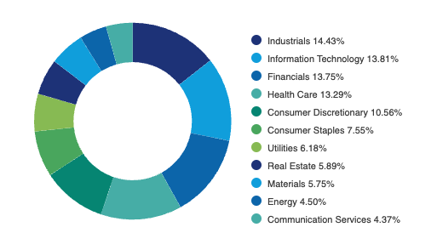
Sector allocation - SPY & RSP
Notes:
Tree Map

Slide 12
keep in mind
SPY is nearly 10 years older than RSP, and this analysis discounts those 10 years of previous and additional returns/dividends.
Investing $10,000 in RSP at $25.25 (Open price on 1st of May 2003) buys 396 shares. RSP pays $2.60 p/s annually.
Investing $10,000 in SPY at $91.91 (Open price on the 1st of May 2003) buys 109 shares. SPY pays $6.46 p/s annually.
$10,000 goes much further when invested in RSP.
Remember, dividends are paid on a per-share basis.
Future analysis could look at the number of shares instead of the dollar amount to counteract the imbalance.

Slide 13
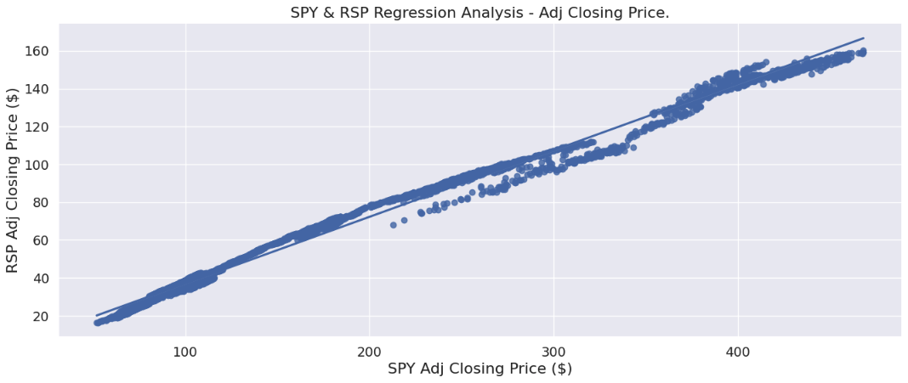
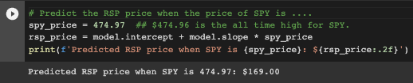
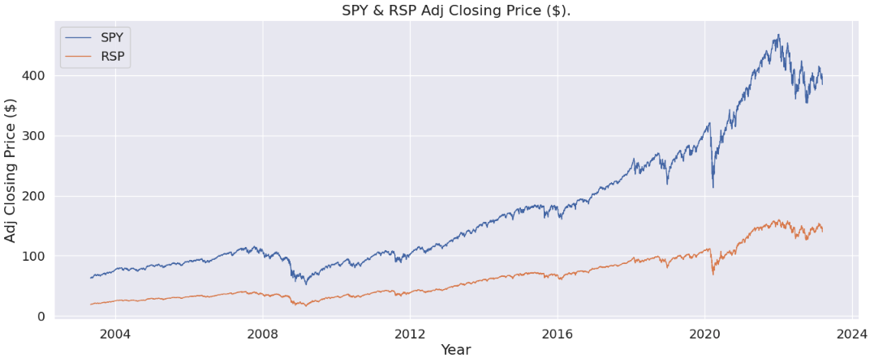
Additional Visualizations.
The regression analysis opposite plots the Adj Closing Price of both funds.
With a correlation coefficient of 0.99, a highly correlated relationship is evident.
Based on this model, we can project the future price of RSP.
LinregressResult – Slope: 0.35, Intercept:1.92, R-value: 0.99, P-value: 0.0,
The line chart opposite plots the Adj Closing price of both funds.
SPY - $62.62 to $385.91 per share.
05/01/2003 – 03/13/2023
RSP - $18.81 to $140.47 per share.
05/01/2003 – 03/13/2023
Notes:
Slope – Determines the direction and magnitude of the relationship between two variables. It helps to determine the rate of change.
Intercept – The point at which the regression line intersects the y-axis. The intercept value is more useful for understanding the overall relationship between the predictor and response variables, and how they are expected to change together across a range of values.

Slide 14
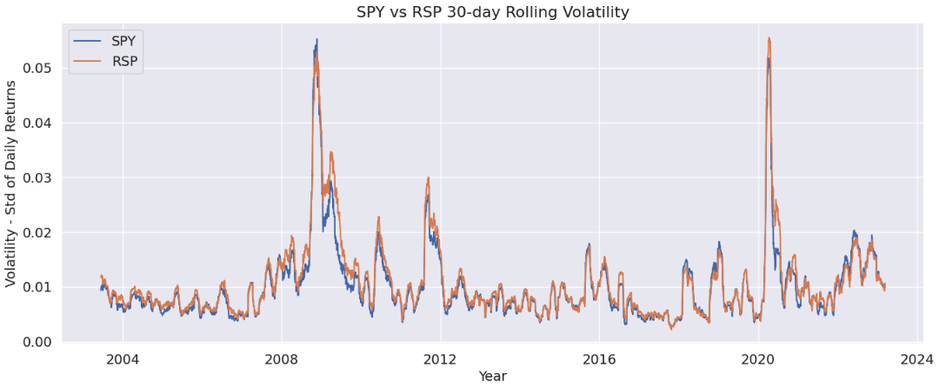
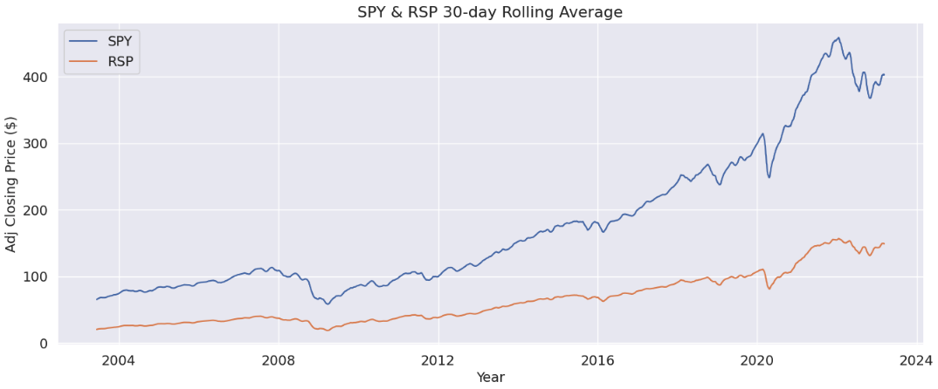
Additional Visualizations Cont.

Slide 15
Questions & comments

